Slide 1
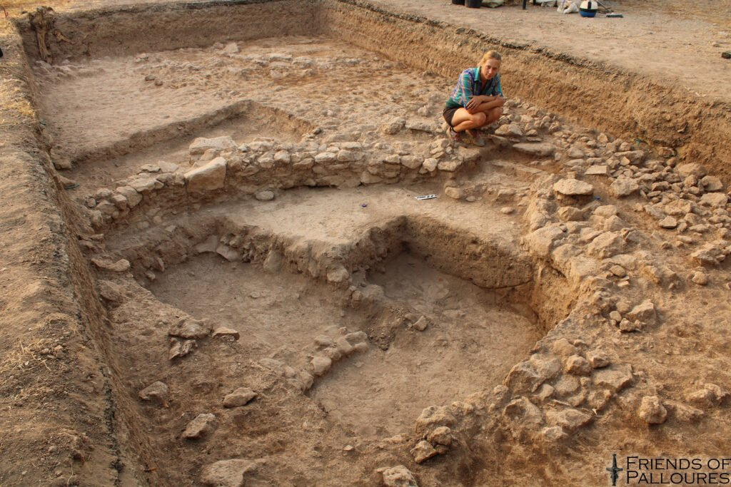
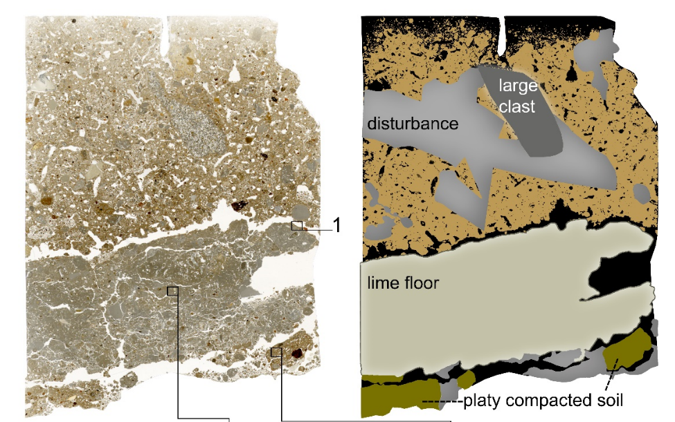
A Humble Abode.
Building Cypriote Society in the
Globalizing World of 3000 BC.
Problem: The Chalcolithic period in Cyprus has often been described as egalitarian and somewhat backward.
Aims: To provide a more comprehensive view on the social structure of the period by focusing on the buildings that people inhabited.
Method: Investigate how these houses were constructed, used and reused, by applying soil micromorphology (figure→)
Results: There was significant variation in status and wealth within society, and the house was used as medium to communicate these differences.

