Slide 1
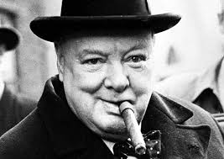
Beyond Rational Persuasion: How Leaders Change Moral Norms
Charles Spinosa
Matthew Hancocks
Haridimos Tsoukas
Billy Glennon

Slide 2
Core argument
Formal leaders, in the face of moral anomalies that defy current moral reasoning, change norms by undertaking morally risky rule-breaking actions with the complicity of followers.

Slide 3
Literature review and research question
Moral entrepreneurship theory
Practice-based leadership
Institutionalism
How do leaders, embedded in practices, bring about radical change in norms among followers through undertaking morally risky actions?

Slide 4
How leaders change norms radically:
A theoretical account
Normative order:
Grounding practices
Organizing practices
Clarifying practices

Slide 5
How normative orders change radically
There is a prevailing normative order where people have a clear sense of what is right to do
A leader is captivated by and calls attention to an anomaly within the prevailing normative order
The leader takes a mild moral risk in proposing actions to resolve the anomaly in a way that goes against the prevailing normative order
The leader takes, and succeeds at, a shocking action in response to the anomaly, but the implicit norm change is only faintly understood
The leader takes, and succeeds at, another shocking moral risk, which is understood; the new normative order arises
Illustration: Churchill changes the British normative order in 1940

