Slide 1

Disentangling Humans:
Genetics and environment as the basis of explaining the self and society
Yiorgos Apidianakis

Slide 2
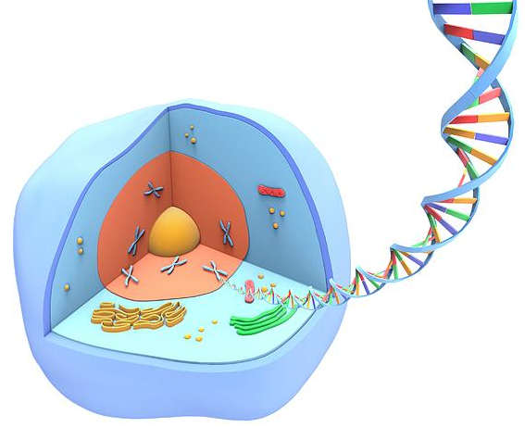
An analogy between Cells & Books
Gene ≈ a word on a page
Chromosome ≈ a page of a book
Genome ≈ all pages of a book
Cell ≈ a book (the unit of life)
Organism ≈ an orderly array of books
Society ≈ a library of books
Genome
Genome

Slide 3
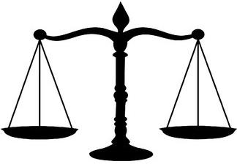
How well
can our Genomes fit nature?
Environmental History
nutrients
people
exposures
microbes
Genome
Genome

Slide 4
All it takes to understand one human or many
regarding any aspect of life
is a close look at the readings
of our Genomes by the Environment

Slide 5
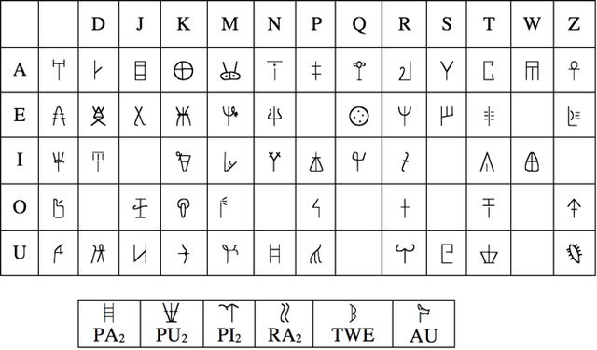
The catch: our Genomes are ancient and
barely understood…
DNA’s archaic language is like the approximate phonetic values of syllabic signs used in Linear A, which are known, while the language itself remains incomprehensible.
Linear A syllabary based on phonetic values of Linear B signs (Cacciafoco et al 2021)

Slide 6
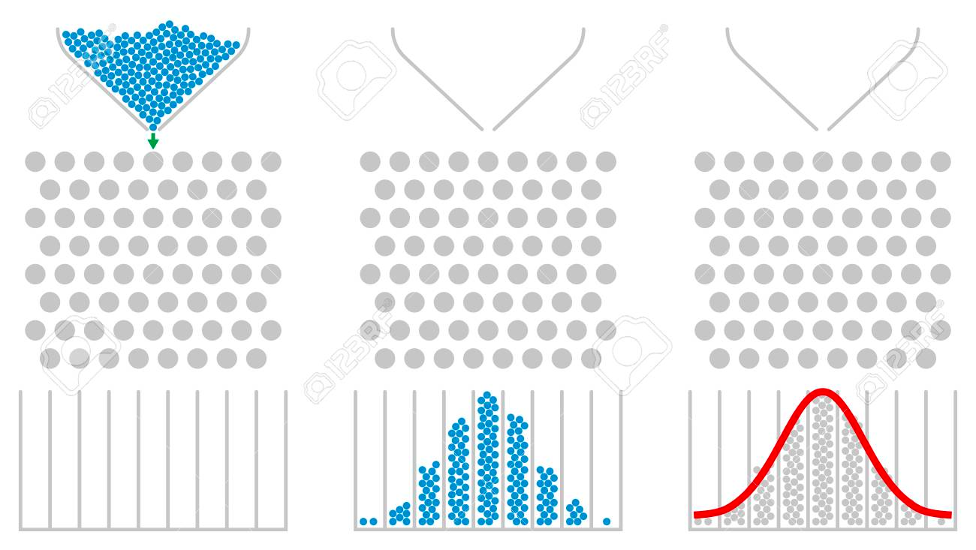
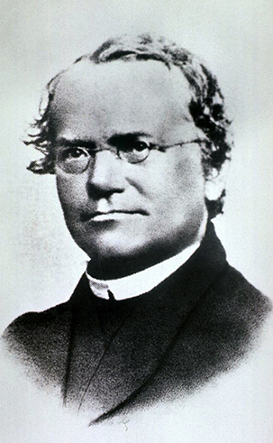
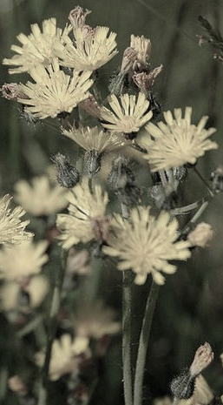
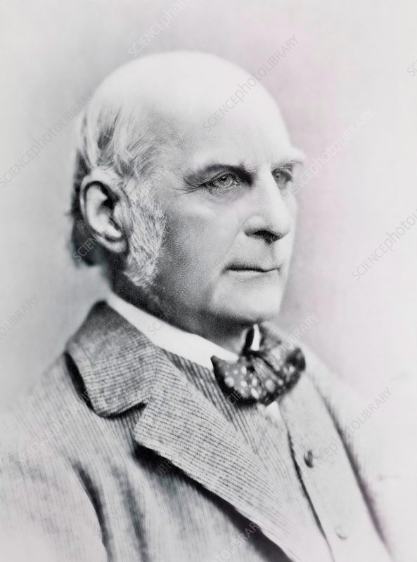
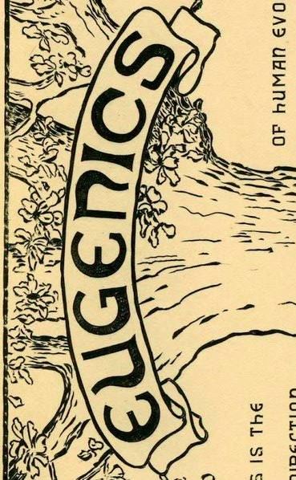
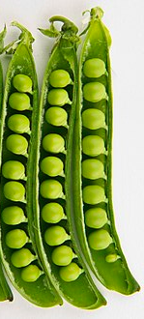
Fathers of Genetics: Gregor Mendel born in 1822, same year as Francis Galton
Mendel’s laws of inheritance were of fundamental value, establishing him post-mortem as the father of Genetics. His approach though was biased, producing results fitting his theories too well. He selected 7 traits & clearly distinctive strains consistent with his laws.
Galton’s biometrics of continuous traits, the inventions of key statistics (normal distribution, standard deviation, regression to the mean) and the concept of additive genetic features distributed to siblings, that he aliked to his own invention of the quincunx.

Slide 7
Phenotypes(Looks/ Function / Behavior) = Genomes x environmental History
P = G
Individual
(Mendelian) & Population
(Galtonian) approach
P
P
P
P
P
P
P
P
P
P
=
G
G
G
G
G
+
E
E
E
E
E
V_{T}
V_{G}
V_{E}

Slide 8
Phenotypes (how much?) = Endotypes (how come?)
Human Looks / Functions / Behaviour
Genome by environmental History
Cause & Effect approach
P = G x E x T = G x H

Slide 9
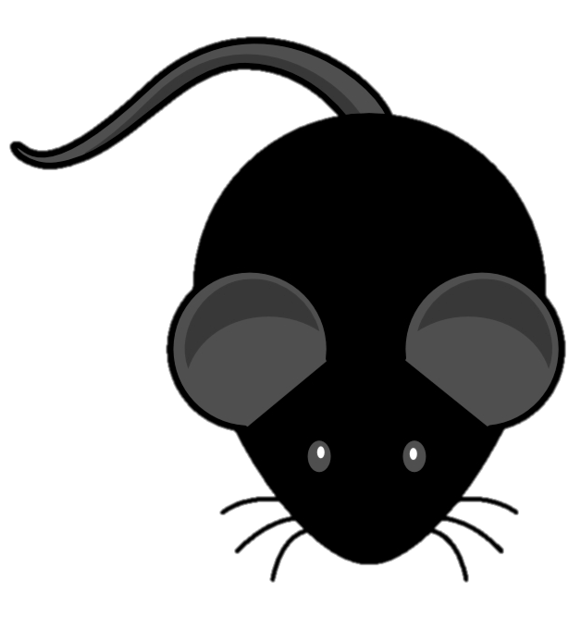
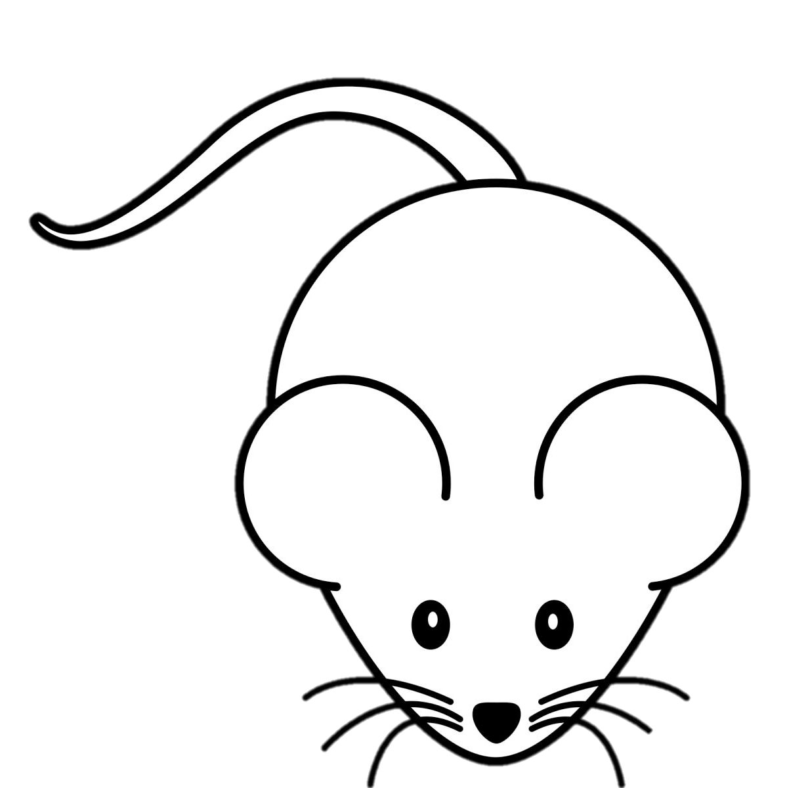
Genomes & Environments
(and why they matter)
Maynard Smith gave an example of how natural selection works in his 1958 book “The theory of Evolution”:
A 100 black + 100 white mouse population prayed upon by owls in a white terrain makes black mice easier to spot (decreasing back mouse fitness).
Surely, “black genes” may help making black pigments
(genetics?)
Maybe mice are becoming black due to the “black food” they eat
(circumstance?)
Maybe mice prefer “black food” via a copycat “black-food-eating” meme
(gene by environment interaction?)
Maybe there is more “black food” in the south ecosystems vs. the north
(purely environmental effect?)

Slide 10
QUESTIONS FOR THE THINKER
(why Genomes & Environments matter):
Which methodological approach is more insightful in explaining human traits, the Mendelian view of humans as individuals or the Galtonian view of humans as populations?
Are there biological limits in achieving the humanitarian ideal of human equality? That is, are there inerasable inequalities among people?
Can we be partially or fully determined by our genes or environments and still responsible for our actions?
When are we more behaviourally free, when we follow our heart or when we plan for the future?
What does it mean to be human? What is more of an objective guide for our politics and ethics, our ideals or our universal behavioural attributes?

Slide 11
Impact of Genomes & Environments
on Human Heath

Slide 12
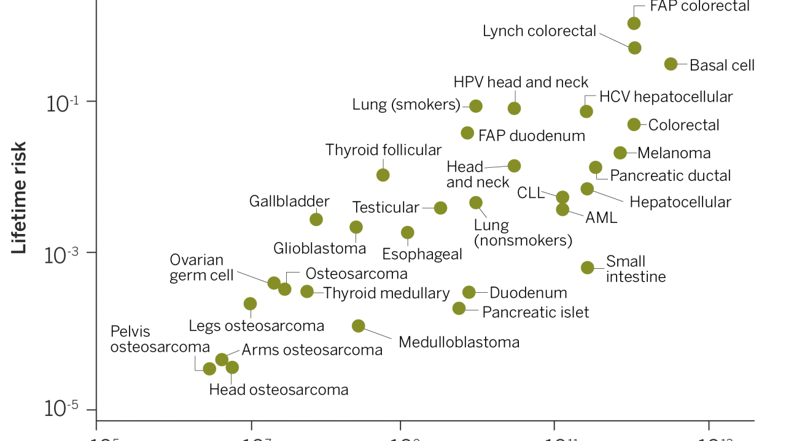
Stem cell replication, naively proposed as a cancer factor independent Genome and Environment
10⁵ 10⁷ 10⁹ 10¹¹ 10¹³
Total stem cell divisions (log₁₀)
Cristian Tomasetti et al. Science 2015

Slide 13
Impact of Genomes & Environments
on Human Progress

Slide 14
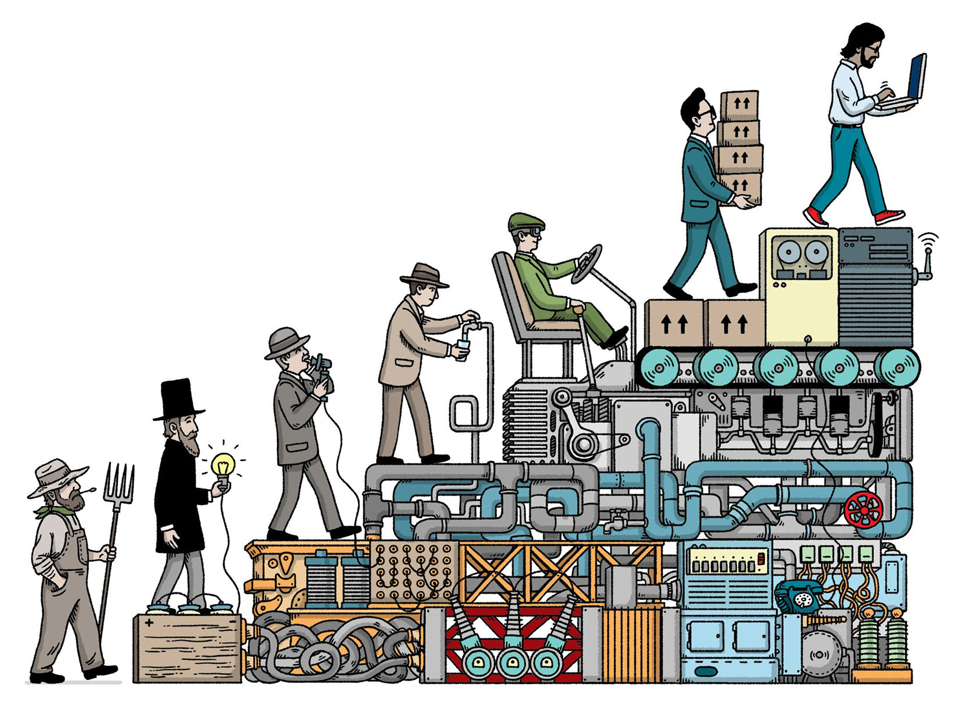
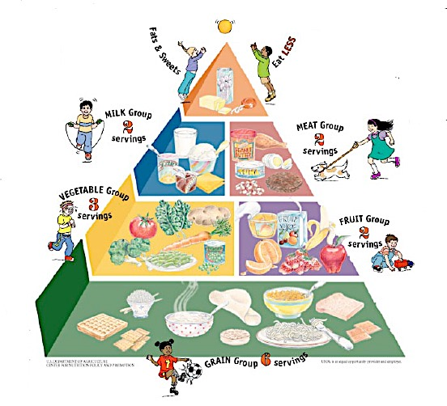
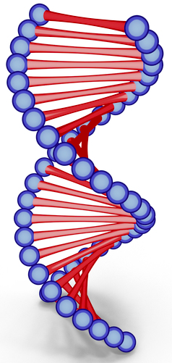
Genome x Environmental History = Phenotype (individual/collective)
Environmental
History
Phenotype (individual/collective)
Genomes
Environmental Histories read our Genomes to shape the individual & collective phenotypes.
Individual & collective phenotypes feedbacks to shape our Genomes & our environmental Histories.

Slide 15
Impact of Genomes & Environments
on Social Human Behavior

Slide 16
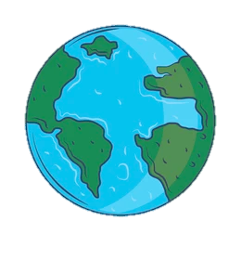
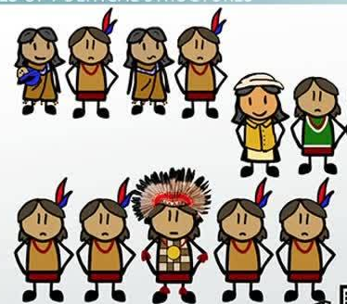
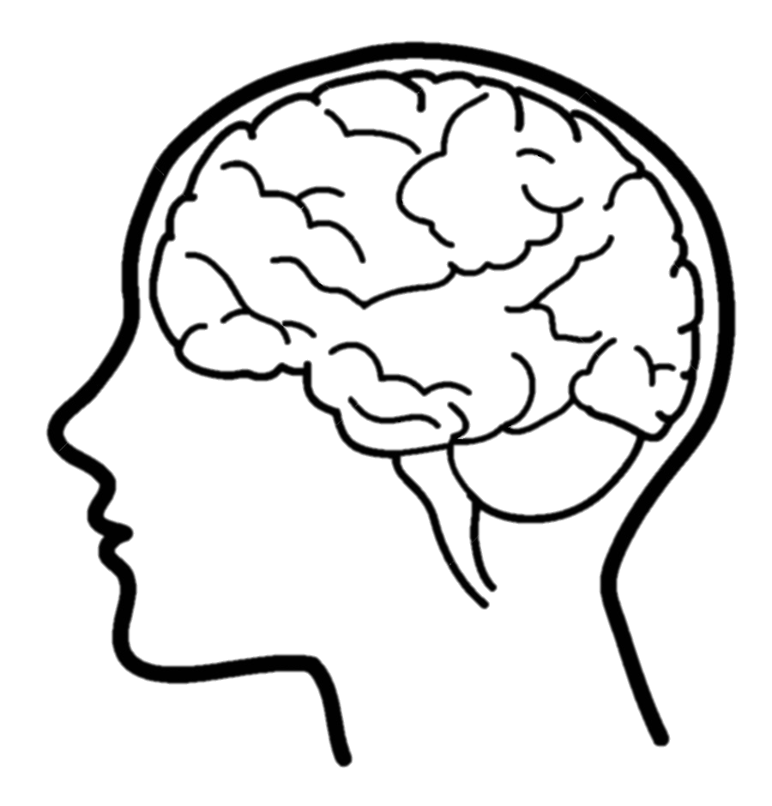
Human cooperation is 3D:
the individual, the population & the global
Cooperation as
Bands & Tribes
Global/blind
Cooperation
Cooperation as
Individuals

Slide 17
Human cooperation develops over time
Today
genetic & mostly cultural predisposition
10,000 years ago
genetic & cultural
predisposition
200,000 years ago
fully genetic predisposition
Cooperation as
Communities, States & Nations
Cooperation as
Communities & States
Cooperation as
Bands & Tribes
Global/blind
Cooperation
Global/blind
Cooperation
Global/blind
Cooperation
Cooperation as
Individuals
Cooperation as
Individuals
Cooperation as
Individuals
Cooperation has a genetic (instinctual) and a cultural (human made environment) basis.
Cooperation evolved genetically and then culturally over time.

Slide 18

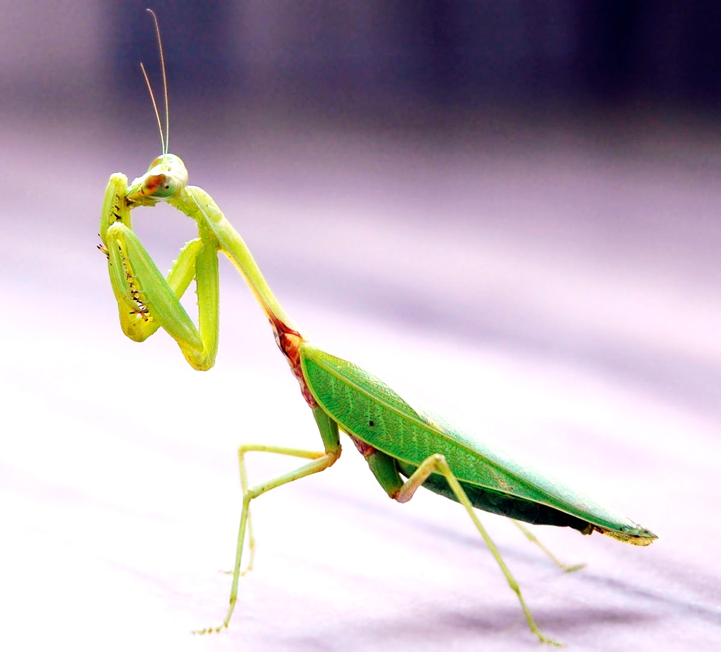
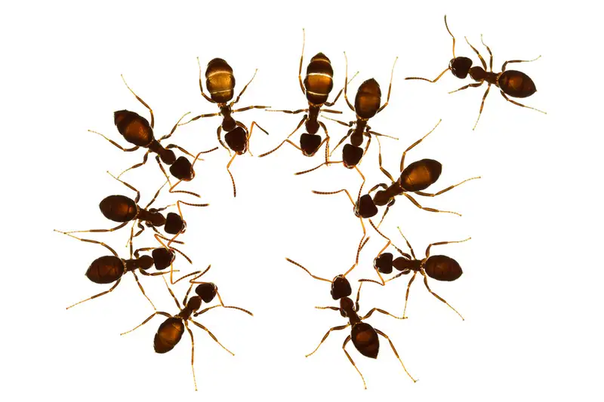
Neither Ants, nor Praying mantis

Slide 19
Prehistory
my people
me
My people are strong.
I am weak, not the focus of wellbeing.

Slide 20
My nation is strong.
I and my people are weak, not the focus of wellbeing.
History
The globe
my nation
my people
me

Slide 21
The globe
Future
my nation
my people
me
I am strong & Globally we our getting stronger.
My nation and my people are not the focus of wellbeing.

Slide 22
A humanist’s, globalist’s view
Partial worldview
is not ideal for humans at any level.
Racist, Religious Fanatic, Elitist, Sexist
Nationalist
Nepotist
Egoist
Egocentricity is
ideal in moderation.

Slide 23
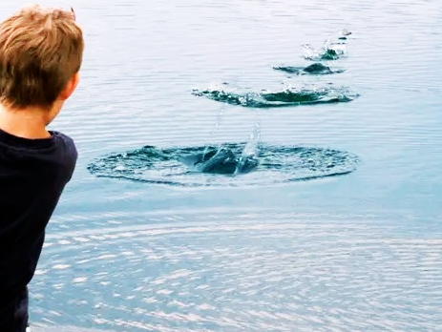
The harmonious
ricochet effect
our globe
YOU
my national alliance
YOU
YOU
my nation
YOU
my city
YOU
my relatives
YOU
my family

Slide 24
The harmonious
ripple effect
vs.
the elliptical
partial effect
What is not harmonious is our often partial, elliptical (racist, fanatic, elitist and sexist) view of our social world and the exploitation by patriarchs and leaders who promote the interests of same-thinking people to the expense of the self or the rest of the world. Prompting Americans towards the public good John F. Kennedy said, “ask not what your country can do for you – ask what you can do for your country”. Prompting the rest of the world to cooperate, he said, “ask not what America will do for you, but what together we can do for the freedom of man”. These powerful words could be taken to mean, “Do what you can for your country, without your country abusing other countries or you”.
The stoic philosopher Hierocles advised viewing humans within concentric social circles, advocating expanding the inner circles so that our attitude towards the self extends to humanity establishing our concern for the world. Biologically also we see the world from the center out, and we can do this more effectively by temporarily moving into the position of our relatives, compatriots and all other humans and animals. Gravitating our concern towards us and those closer to us is only natural, because the center, our self, is seen and felt and must be taken care of more immediately.

Slide 25
Impact of Genomes & Environments
on Human Politics

Slide 26
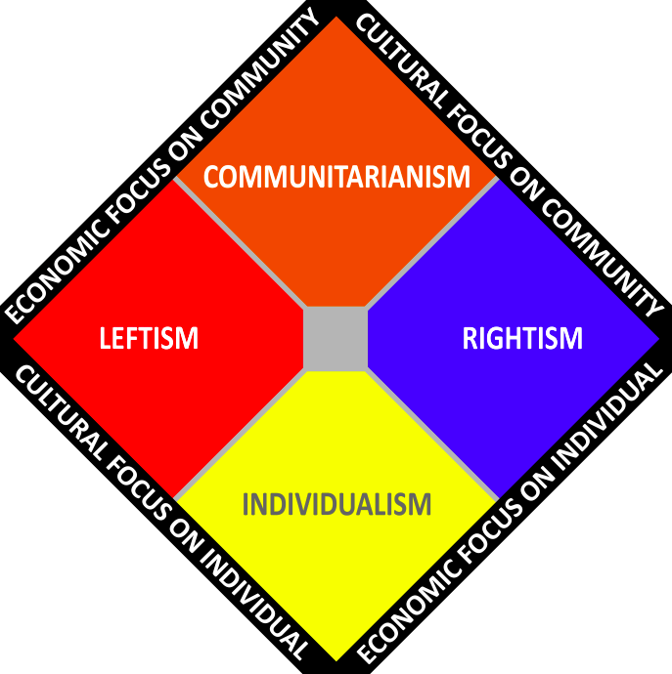
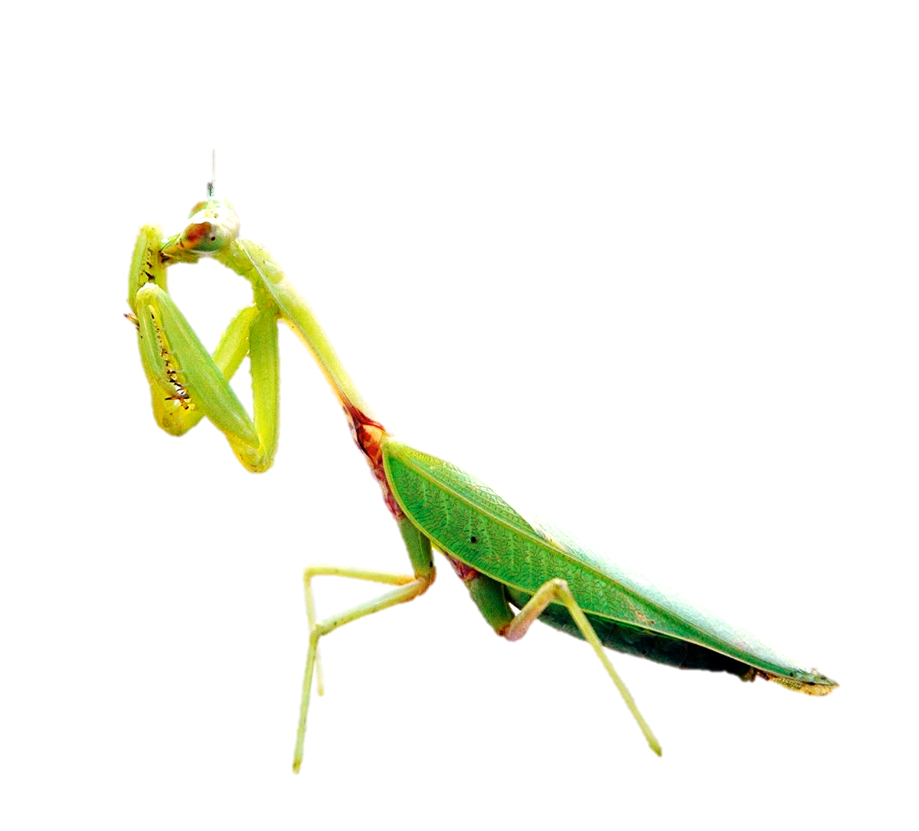
COMMUNITY IS EVERYTHING
RESOURCES ACCORDING TO NEED
ABIDING TO COMMUNITY VALUES
COLLECTIVISM
The middle way
SHARING HABITS
not resources
SHARING RESOURCES
not habits
LEFTISM
RIGHTISM
INDIVIDUALISM
ALLOWING SELF-EXPRESSION
RESOURCES BASED ON EXCELLENCE
EGO IS EVERYTHING

Slide 27
Cooperation & Competition hidden within our Genomes:
From Nucleotides to Inter-National unions
RNA
3.8 Billion Years
Globe
Ongoing Alliances
DNA chromosomes
3.6 Billion Years
From early life nucleotide cooperation against natural entropy…
to the current humanity cooperation against natural & manmade entropy
States/Nations
3,000 Years
Eukaryotic
Cells
2 Billion Years
Human Settlements
10,000 Years
Multicellular Organisms
<0.7 Billion Years
Humans organized in bands & tribes: 300,000 Years

Slide 28
Impact of Genomes & Environments
on Free Will

Slide 29
How free is free?
We did not choose:
The time and place we were born in.
Our genomes.
Our parents and relatives.
Our primary education and experiences.
As adults we may think we can freely choose:
How we feel, behave and act
At any given moment, our genomes and environments have planned our significant choices for us.
However, only our proactive actions have a dose of freedom.

Slide 30
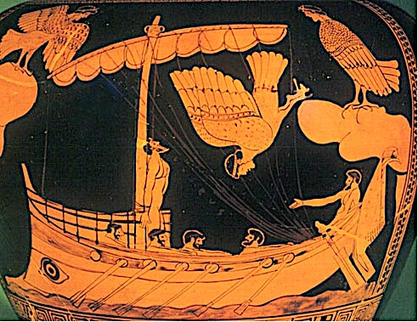
How free is free?
We can only act freely when proactively (within limits)
on what we might be wanting in the future, like Ulysses and his sailing mates
Knowing the Sirens will lure them all with their singing and use them for food Ulysses asked to be tied on the mast and his sailing mates be ear-plugged as they pass by Sirens’ island to escape what they would be wanting in the future.
Ulysses could not resist the bewitching song of the Sirens, but he could act proactively!

Slide 31
We are never really free
Deterministic grip: Human traits are determined
at any given point in time by GxH
Adult
fully within
GxH grip
Senior
fully within
GxH grip
Baby
fully within GxH grip
Personal Phenotype Range
Time

Slide 32
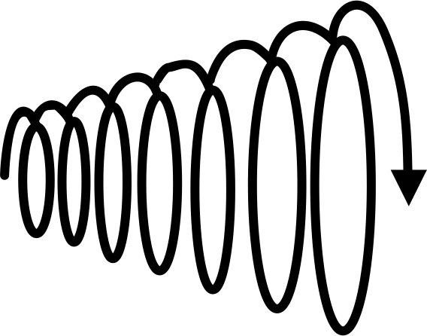
We are never really free, but…
Step-by-step planning of GxH: planning of changing our traits, relaxes our FUTURE deterministic grip
Planning relaxes our FUTURE GxH grip
Personal Phenotype Range
Time

Slide 33
Step-by-step planning of GxH
…allowing us to move in an other direction
Personal Phenotype Range
Time

Slide 34
Step-by-step planning of GxH
Personal Phenotype Range
…or yet another direction
Time

Slide 35
Human Phenotypes & the continuity of knowledge
Artificial thinking
Philosophy & Science
Art, history, language
Behavior (tools, psychology, sociology)
molecular, cellular, tissue biology, physiology (medicine)
Genetics ➔ PHENOTYPE ⬅ Evolution
chemistry
mathematics
physics
chemistry
mathematics
chemistry
chemistry
chemistry
physics
mathematics
mathematics
physics
mathematics
physics
physics
chemistry

Slide 36
Chronology of our knowledge of humans & the consciousness-related gap in its continuity
20th century
Antiquities
Prehistory & Antiquities
Consciousness mystery gap
19th – 20th century
20th century
19th century
Antiquities
17th – 18th century
Renaissance

Slide 37
Filling the consciousness-related gap will establish the continuity in our knowledge of humans
21st century Cognitive Neuroscience & Evolutionary Psychology may explain:
How distinct neural signals and circuits work to bring about consciousness
How do we display sensuous signals in our consciousness (maybe by giving them some distinct but arbitrary feeling, like program/folder/file icons displayed on our desktop).

Slide 38
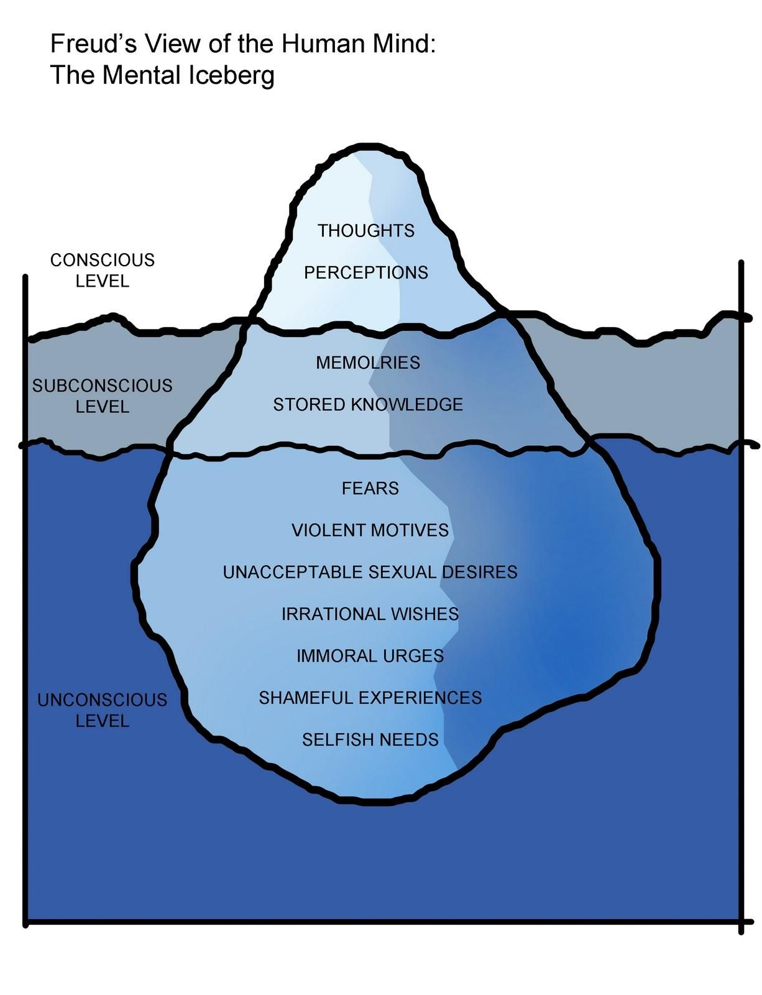
Balanced Brain Operation: our thoughts and perceptions are on the top of the iceberg
Homeostatic mechanisms
Body function operations

Slide 39
We are only macro-managing (loosely supervising) our brains

Slide 40

Consciousness is an operator - orchestrator of body & mind.
A Phenotype, a display, overseeing our operating system.

Slide 41
