Slide 1
Designing the Next Generation of Urban Water Distribution Systems:
ERC Water-Futures Project
Prof. Marios M. Polycarpou
Dept. Electrical and Computer Engineering, University of Cyprus
KIOS Research and Innovation Center of Excellence
Member, Cyprus Academy of Sciences, Letters and Arts
Nicosia, 9 May 2022

Slide 2
Cyber-Physical Systems (CPS)
Cyber Part
physical part: physical, biological or engineered systems that are usually large-scale & complex
cyber part: communication networks & computational resources for monitoring, controlling & coordinating the physical part
Physical Part

Slide 3
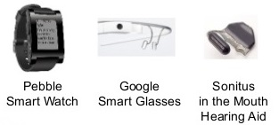
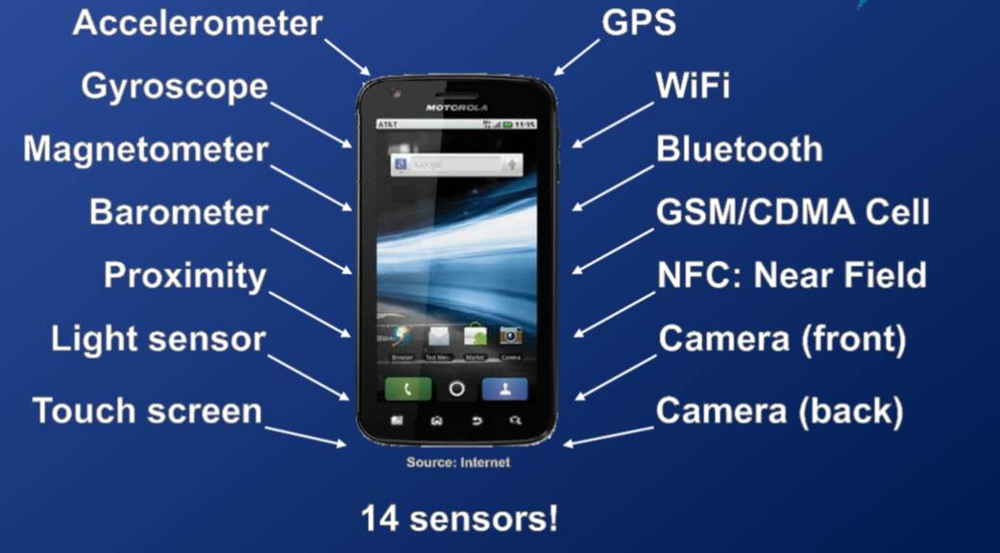

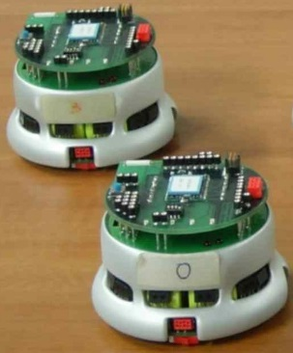
From Traditional Systems to CPS
Sensor technology
  wealth of sensors
  new generation sensors
Information & Communication Technology (ICT)
  store, process and transmit data collected by sensors

Slide 4

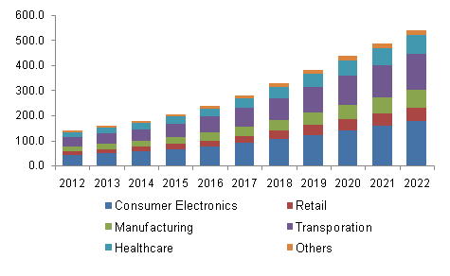
From Traditional Systems to CPS
Internet of Things
  sensor enabled devices connected to the internet and able to communicate with each other
Big Data
  sensor technology and ICT enabled the collection of extremely large data sets
  contribute to the better perception of complex systems

Slide 5
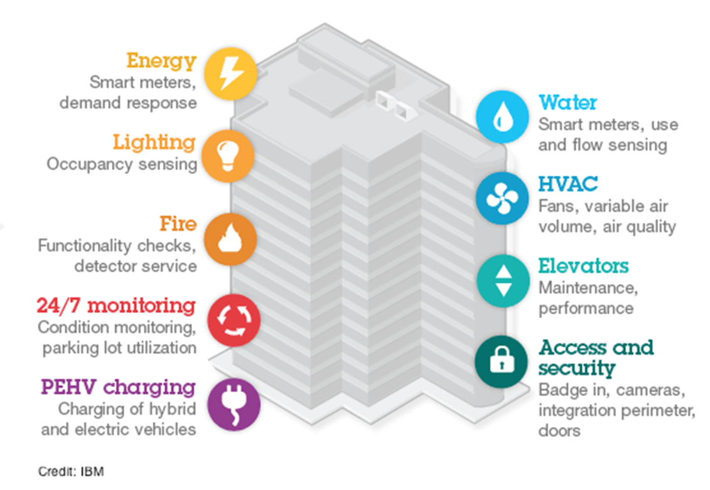
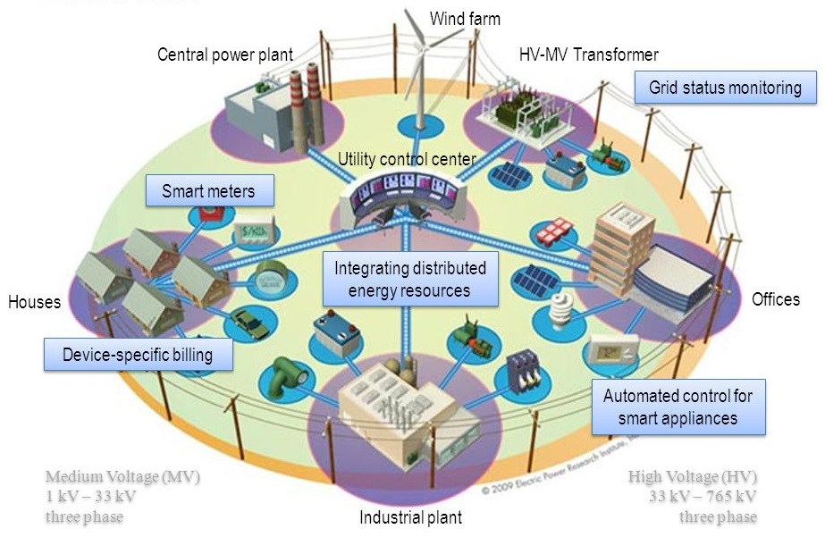
Examples of Cyber-Physical Systems
  Smart Grid
  Smart Buildings

Slide 6
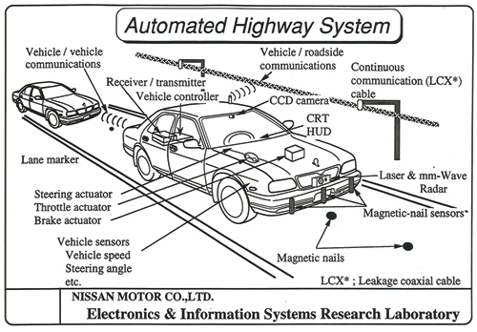
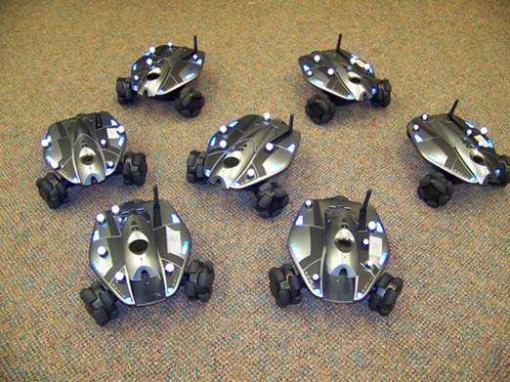
Examples of Cyber-Physical Systems
  Intelligent Transportation
  Multi-robot formation

Slide 7
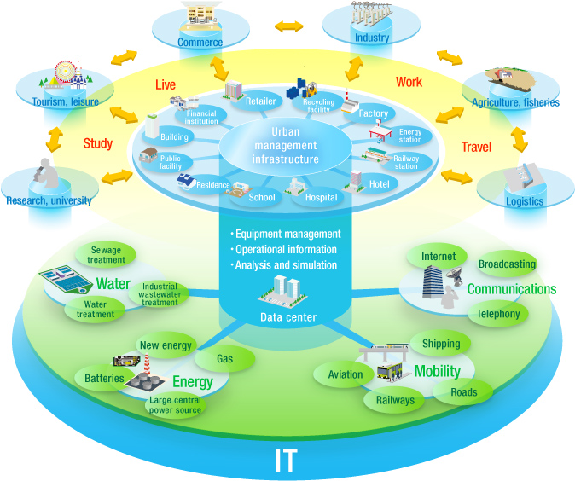
Examples of Cyber-Physical Systems
  Smart Cities: a network of interconnected CPS
Physical Interconnections
Cyber Interconnections
Interdependencies

Slide 8
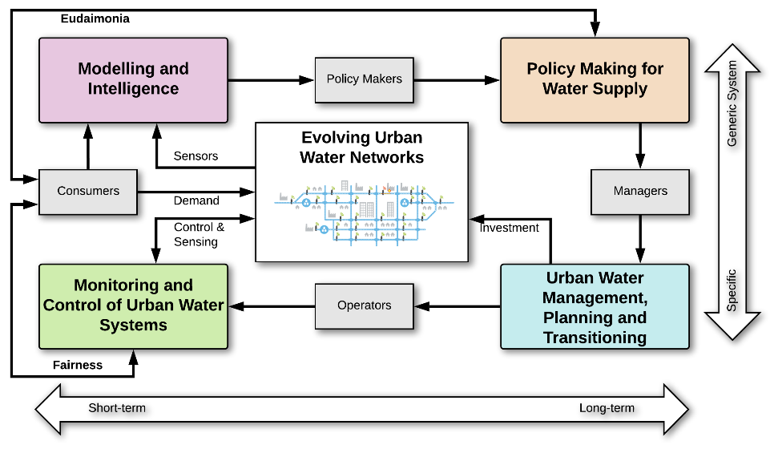
Water Distribution Networks: an example of a cyber-physical-social system

Slide 9
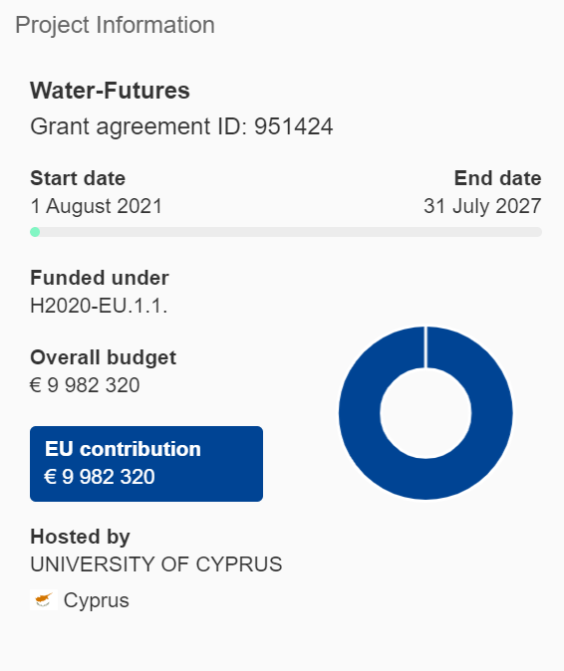
Project outline
Smart Water Futures: designing the next generation of urban drinking water systems
Acronym: Water-Futures
Beneficiaries:
  University of Cyprus (Cyprus)
  Bielefeld University (Germany)
  Athens University of Economics and Business (Greece)
  KWR Water Research Institute (Netherlands)
  University of Exeter (UK)
Total budget: € 9,982,320
https://cordis.europa.eu/project/id/951424

Slide 10
What is the ERC Synergy Grant?
Funded by the EU’s Horizon Europe Framework Programme
European Research Council (ERC) Frontier Research Grants aim to empower researchers and foster their creativity
ERC Synergy Grants enable up to 4 Principal Investigators and their teams, to jointly address ambitious research problems that could not be addressed by each team alone.
Enable substantial advances at the frontiers of research
Transformative research with potential to become benchmark on a global scale

Slide 11
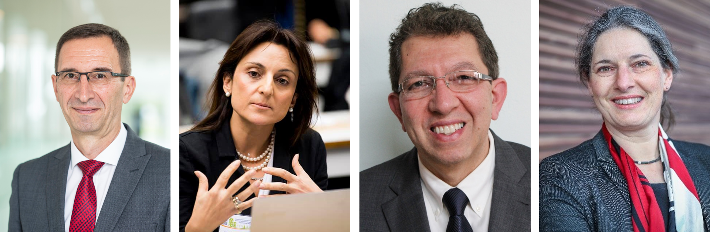
Principal Investigators
Prof. Dragan Savić
KWR Water Research Institute &
University of Exeter
Prof. Phoebe Koundouri
Athens Univ. of Economics and Business
Prof. Marios Polycarpou
KIOS Research and Innovation Center of Excellence,
University of Cyprus
Prof. Barbara Hammer
Bielefeld University

Slide 12
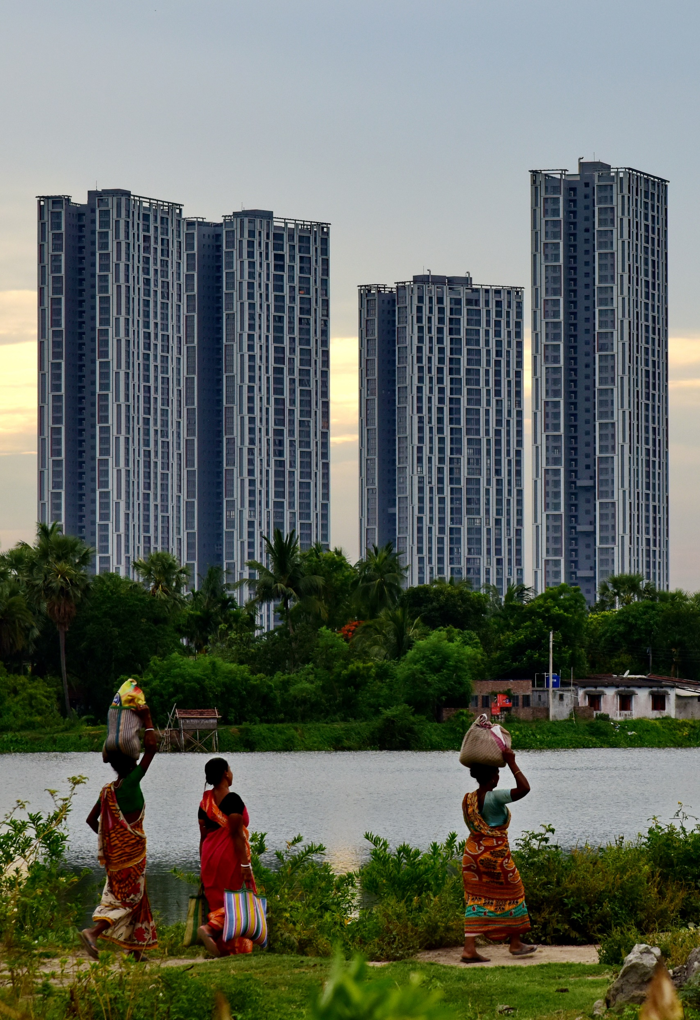
The future of water challenge
80% of the world’s population is exposed to high levels of threat to water security due to anthropogenic climate change
70% of the world’s population will live in urban areas by 2050
Urbanization and climate change will cause increased water demand
Urban water distribution systems: complex, large-scale, time-varying, long-lasting networks

Slide 13
Scientific question
How should the world achieve the provisioning of high-quality water services in the future while facing severe climate, economic and population pressures, under deep uncertainty?

Slide 14
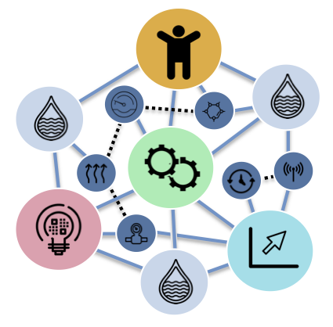
A new theoretical framework
Need a holistic, intelligent decision-making framework for managing water infrastructures in the cities of the future:
adapt to evolving urban water networks, new sensing technologies and consumer behaviours;
integrate real-time monitoring and control with long-term planning and policy making;
assimilate water quality issues with water supply problems; and
incorporate economic, social, ethical and environmental considerations.

Slide 15
Project objectives
To develop theory and application of robust and flexible decision support strategies to cope with deep uncertainty associated with urban water systems that evolve over time.
To develop new real-time distributed monitoring and evolving control methodologies for water systems in order to support the ability to learn from experience acquired from other parts of the system, and to interact with uncertain human decisions, considering both short-term and long-term planning goals.
To develop Explainable Machine Learning models in non-stationary environments for complex structured and networked data to seamlessly support human decision making for smart water systems by data-driven technologies.

Slide 16
Project objectives
To develop a methodology that integrates economic, social, ethical and environmental considerations, with direct relevance to UN Agenda 2030 into an interdisciplinary decision-support framework that will allow agent-based societal welfare maximization in the short, medium and long-run, under deep uncertainty.
To design and implement an open-source toolbox that integrates the scientific outputs produced, and the demonstration of the different methodologies developed by the research team, in three urban water systems in the Netherlands, Cyprus and Mexico.

Slide 17
Concept
Provide the theoretical and practical basis for enabling stakeholders, policy makers, managers and operators:
Make socially-acceptable and fair decisions (for the consumers)
Balance real-time and short-term decisions as well as long-term infrastructure transitioning and planning
Focus on evolving urban water distribution systems under multiple possible futures and deep uncertainties

Slide 18
Work packages
WP1: Optimisation-based Sequencing for Transitioning of Urban Water Systems under Deep Uncertainty
WP2: Distributed Monitoring and Evolvable Control
WP3: Explainable Machine Learning to support robust decision making by data-driven technologies
WP4: Achieving Eudaimonia; a new theoretical and applied sustainable socio-economic
WP5: Water-Futures Research Toolbox and Case Studies

Slide 19
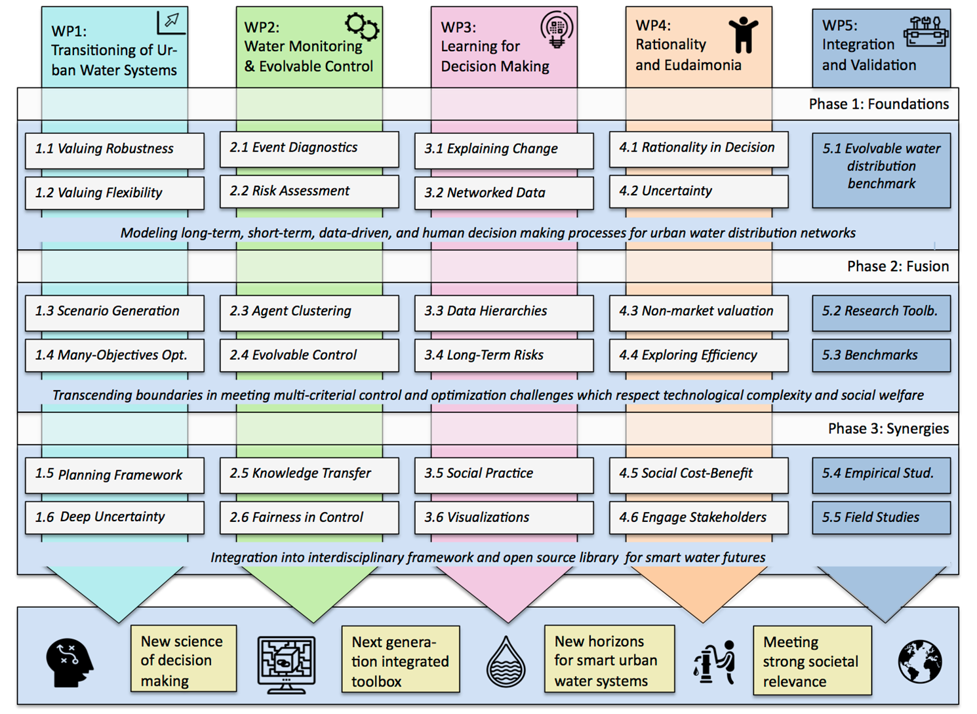

Slide 20
Impact
The project will result in a theoretical and practical basis for a generic framework, together with applied research tools, that could support decisions for the provisioning of future water services to more than two-thirds of the world’s population that is expected to inhabit our cities by 2050.
Nurture scientific talent; training of researchers in new methods for water distribution systems
Wider societal impact: building awareness; influencing policymakers; engaging the public.

Slide 21
Thank you!

