Slide 1
Research Synthesis and Meta-Analysis
Zacharias Maniadis and Lunzheng Li,
SInnoPSis, University of Cyprus
ONISILOS Seminar, 20 November 2024

Slide 2
Intended Learning Outcomes
By the end of this lecture, you should be able to:
Define meta-analysis, discuss its characteristics and explain its usefulness and contribution to science.
Summarize the steps necessary to conduct a meta-analysis.
Access online resources for preregistering a meta-analysis, as well as searching, selecting and annotating literature.
Reflect on the statistical challenges behind summarizing the evidence and correcting for possible bias.

Slide 3
Roadmap
Defining Meta-Analysis and Discussing its Background.
Steps of Meta-Analysis.
  Preregistration.
  Literature review.
  Statistical assessment.
  Choosing effect sizes.
  Modelling main effects, heterogeneity, and correcting for biases.
  Inference about effects and literature.
Conclusions

Slide 4

The Need for Research Synthesis
Science aims to discover regularities and truths about the world.
Each study unveils only a small part of such truths.
We need to make sense of the literature as a whole. A survey or narrative review discusses the results of a broader literature.

Slide 5
Meta-Analysis
A meta-analysis quantitatively synthesizes a literature comprising of empirical evidence.
  E.g. effect of a cancer drug on mortality.
It gives us an overall effect of a variable and informs us about sources of variation.
It also uncovers biases and weaknesses in the literature.
It is less subjective than narrative review, since conclusions are driven by statistical summaries.
Notes:
Research exploring the same question often produces varying or even conflicting findings that could potentially be due to a range of factors. When findings conflict or do not replicate, it can be unclear why this might be the case, what the overall picture is, what important questions remain unanswered, or which results are most reliable and should be used as the basis for practice and policy decisions.

Slide 6
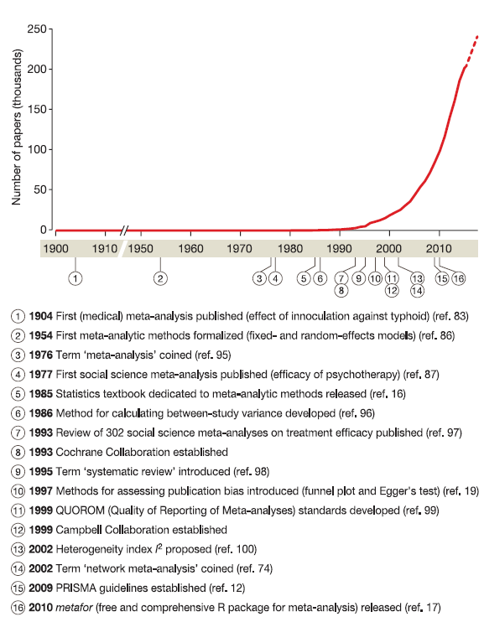
Historical Developments
First defined by Gene Glass
Takes off after Cochrane collaboration is established

Slide 7
Meta-Analysis is Topical
Meta-analysis is closely related to the recent developments in big data and open science.
Systematic reviews aim to be transparent, reproducible and updatable.
Use of formal methodological guidelines for the literature search, study screening, data extraction and coding.
Transparent documentation: software, protocols and reporting guidelines are well established in many fields.
PRISMA (Preferred Reporting Items for Systematic Reviews and Meta-Analyses).

Slide 8
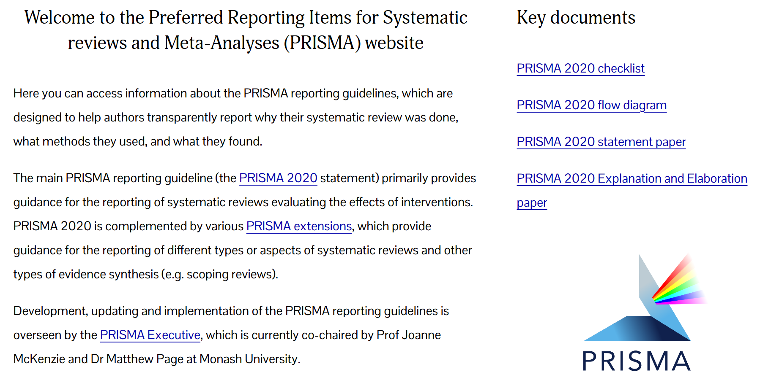

Slide 9
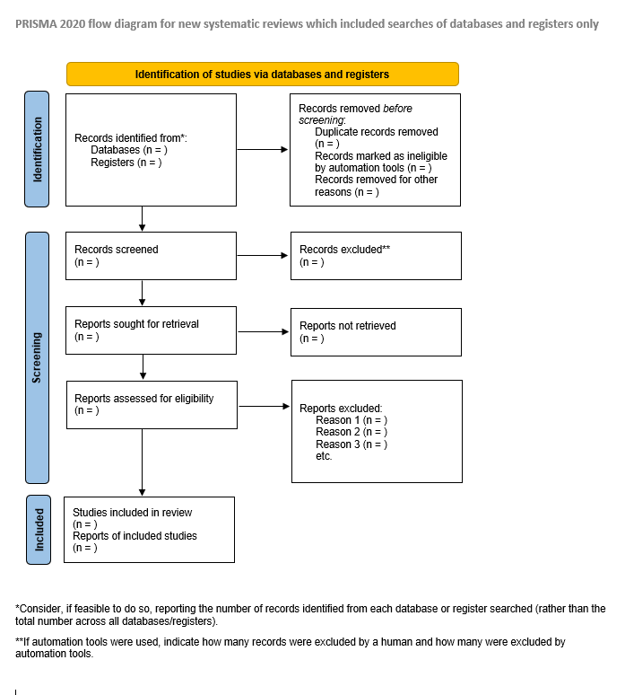

Slide 10
Meta-Analysis is Costly
Systematic reviews require different resources compared to other forms of research.
An involvement of key contributors in the literature is usually necessary.
Systematic reviews are labour intensive, often requiring a team of researchers working over a substantial period of time.
On average, 5 members are involved in conducting a systematic review, while mean time period to publication is 67.3 weeks.

Slide 11
The Challenge
The field of meta-analysis uses a set of statistical techniques.
These are applied in literatures ranging from medicine, ecology, evolutionary biology to psychology and economics.
Scientists in these domains have topical expertise, but often lack advanced training in meta-analysis.
This results in a high number of low-quality meta-analyses.

Slide 12
The Solution
A strong understanding of the difficulties in conducting a meta-analysis and methods to overcome them is critical.
There are many statistical packages and resources.
The real skill for generating and analysing high-quality meta-data is understanding what methods to use.
This seminar aims to help young researchers in this direction.

Slide 13
STEPS OF META-ANALYSIS

Slide 14
Proceed with Meta-Analysis
Decide on effect sizes to be extracted
No meta-analysis possible: STOP
Statistical model to assess overall effects and heterogeneity in outcomes.
Statistical Assessment of literature
Assessment of Bias
Literature Search
Central Tendency
Confidence Limits
Assessment of Heterogeneity
Pre-registration
Inference from the evidence
Notes:
Effect sizes are designed to put the outcomes of the different studies being combined on the same scale, using a suite of metrics that includes odds and risk ratios, standardized mean differences, z-transformed correlation coefficients and logarithmic (‘log’) response ratios. Effect sizes must be readily interpretable, scientifically meaningful and comparable among meta-analyses, and for its sampling distribution to be known, so that statistical models can be constructed appropriately
The common-effect (or fixed-effect) model assumes that variation in effect sizes among studies is due to within-study (sampling) variance and that all studies share a common ‘true’ effect. The random-effects model assumes that, in addition to sampling variance, the true effects from different studies also differ from one another, representing a random sample of a population of outcomes, and is analogous to a random-effects model in an analysis of variance (ANOVA)

Slide 15
Preregistration
Prospective registration aims to reduce bias in the conduct and reporting of research and to increase transparency.
  Pieper and Rombey, 2022
Help preventing unintended duplication, thereby reducing research waste.
PROSPERO was launched in 2011 as prospective register for systematic reviews.
  https://www.crd.york.ac.uk/PROSPERO/
  Preregistration

Slide 16
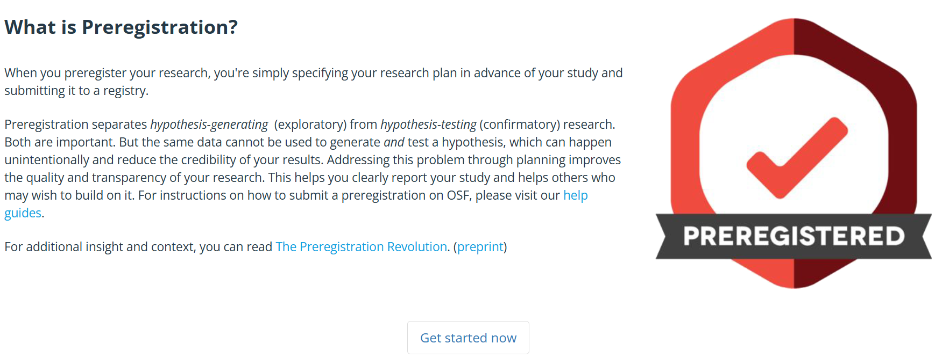

Slide 17
Searching and Selecting Relevant Studies

Slide 18
Searching Online Libraries
General: Web of Science Core Collection (includes the Science Citation Index)
Biomedicine: PubMed, Embase, Cochrane Central Register of Controlled Trials, ClinicalTrials.gov, BIOSIS Previews, CINAHL, WHO Global Index Medicus
Social Sciences: PsycINFO, Sociological Abstracts, 3ie Impact Evaluation Repository, EconLit, RePEc IDEAS
Gusenbauer, M. and Haddaway, N.R., 2020. Which academic search systems are suitable for systematic reviews or meta‐analyses? Evaluating retrieval qualities of Google Scholar, PubMed, and 26 other resources. Research synthesis methods, 11(2), pp.181-217.

Slide 19
Selecting Studies
Process of deciding studies to include for final consideration needs to be as objective as replicable as possible.
  Clear inclusion/exclusion criteria.
  Multiple coders require measurements of reliability and consistency of coding.
  Careful organization among different coders is necessary.
Tools: Rayyan, AS review

Slide 20
A. Inclusion and Exclusion Criteria
Very important to define them clearly and ex ante.
Examples include:
  Research questions (topic, scope).
  Measures or key variables (what is measured and how).
  Search design (e.g., observational studies, experimental studies, etc.)
  Participants (e.g., adults, children, etc.)
  Time frame.
  Availability of statistical information.

Slide 21
B. Subjective Coding Reliability
Is the coding process meaningful and reproducible, especially if different coders are involved?
  Intertemporal reliability.
  Interpersonal reliability.
Multiple coders should code a given sample of the literature. Then, consistency across coders needs to be elicited.
  Cohen’s κ, Krippendorff’s α, etc. (Belur et al., 2021)
Notes:
When multiple observers are observing the same phenomenon, some variation in outcome is likely. This begs answers about the reliability of the observation. Various explanations have been put forward to account for variance in coder behavior. Armstrong et al.’s (1997) study on coder agreement for qualitative data reports that while there was broad agreement on themes in their study, coders “packaged” concepts differently depending upon their geography, discipline, or personal differences in experiences or views. Thus, three important factors affecting how concepts are “packaged” are the background of coder, their domain knowledge, and their research experience more broadly.

Slide 22
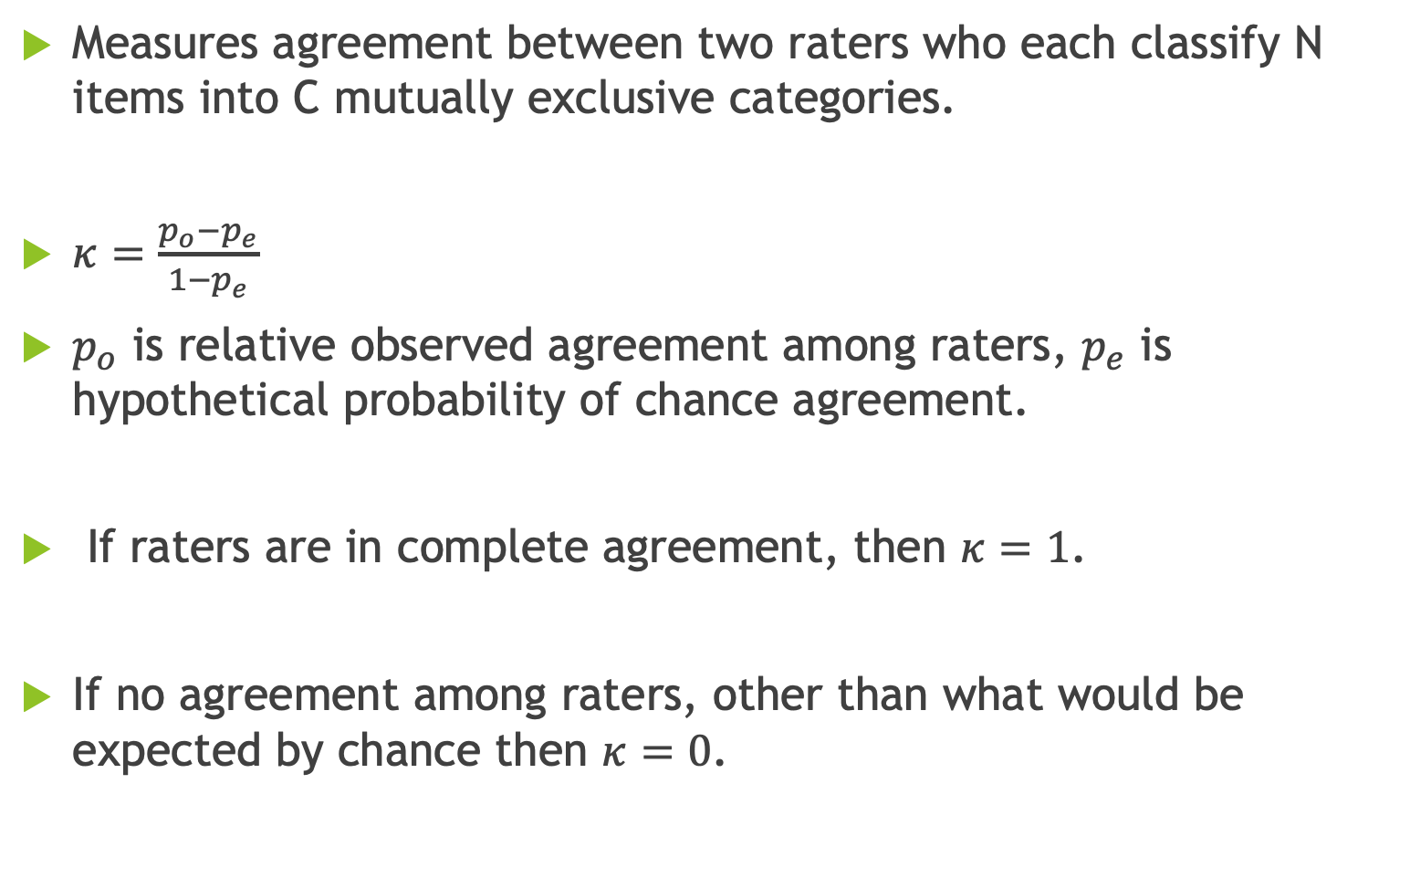
Cohen’s κ
Measures agreement between two raters who each classify N items into C mutually exclusive categories.
$κ=\frac{p_{o}−p_{e}}{1−p_{e}}$
$p_{o}$ is relative observed agreement among raters, $p_{e}$ is hypothetical probability of chance agreement.
If raters are in complete agreement, then $κ=1$.
If no agreement among raters, other than what would be expected by chance then $κ=0$.

Slide 23
C. Organization Among Different Coders
Thousands of articles need to be selected and distributed among different coders.
Coders need to screen different parts of articles (e.g. title, abstract, introduction, full article).
Opening and organising PDFs saved in an archive can be very time consuming.
Fortunately, automatic online tools can be used to facilitate this process.
  SyRF - Systematic Review Facility

Slide 24
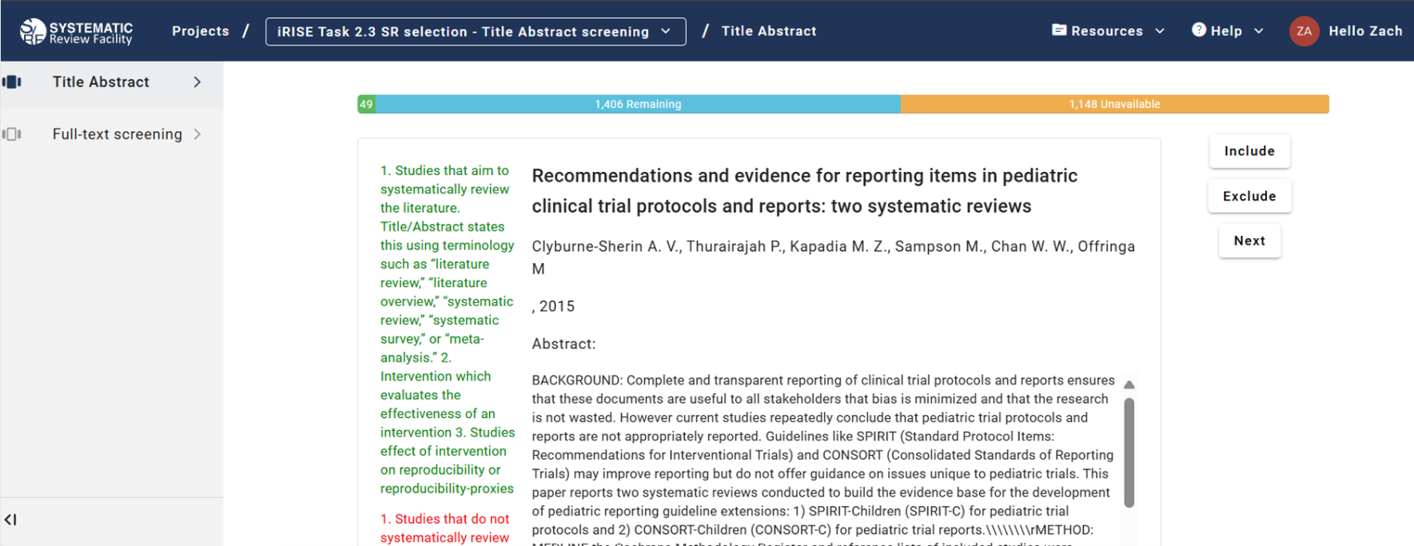

Slide 25
3. Statistical Assessment of Literature
A crucial step is to decide whether it makes sense to proceed with our meta-analysis.
This judgment needs to take place when we are done with our literature search and coding.
While it is possible to conduct a meta-analysis with very few studies, it is important for it to be informative and provide definite conclusions. For instance, meta-regression analysis cannot be conducted with less than 10 studies.
Easy to fall trap to the ‘Sunk Cost Fallacy’.

Slide 26
Deciding on Effect Sizes

Slide 27
What are Effect Sizes?
Effect sizes quantify the magnitude of a relationship or difference in studies.
Theoretically, any metric can be used as an ES as long as it is takes into account the magnitude and direction of a relationship, can be expressed as a point estimate with confidence intervals, and provides estimates that are comparable across studies.
Most ES metrics fall into three main categories, related to proportions (e.g. Odds Ratios), means (e.g. Standardized Mean Differences), and correlation coefficients (e.g. Pearson’s Correlation Coefficient).

Slide 28
How to Choose an Effect Size?
Comparability Across Studies:
  The effect sizes should be comparable across studies, meaning they must measure (at least approximately) the same construct.
Computable from Published Data:
  It should not require re-analysis of raw data unless these are readily available.
Good Technical Properties:
  The effect size should have known sampling distributions, allowing for the computation of variances and confidence intervals.
Meaningful and interpretable:
  If necessary, it can be transformed into a more interpretable metric (e.g., log risk ratio to risk ratio).

Slide 29
Practical Application
For Continuous Data (e.g., means and standard deviations):
  Standardized mean difference (SMD).
  Hedges’ g/Cohen’s d.
For Binary Outcomes (e.g., events vs. non-events):
  Risk ratio (RR).
  Odds ratio (OR).
For Correlation Data (e.g., relationships between continuous variables):
  Pearson’s Correlation Coefficient.
  Fisher’s z-transformation.
  Spearman’s Rank Correlation Coefficient.

Slide 30
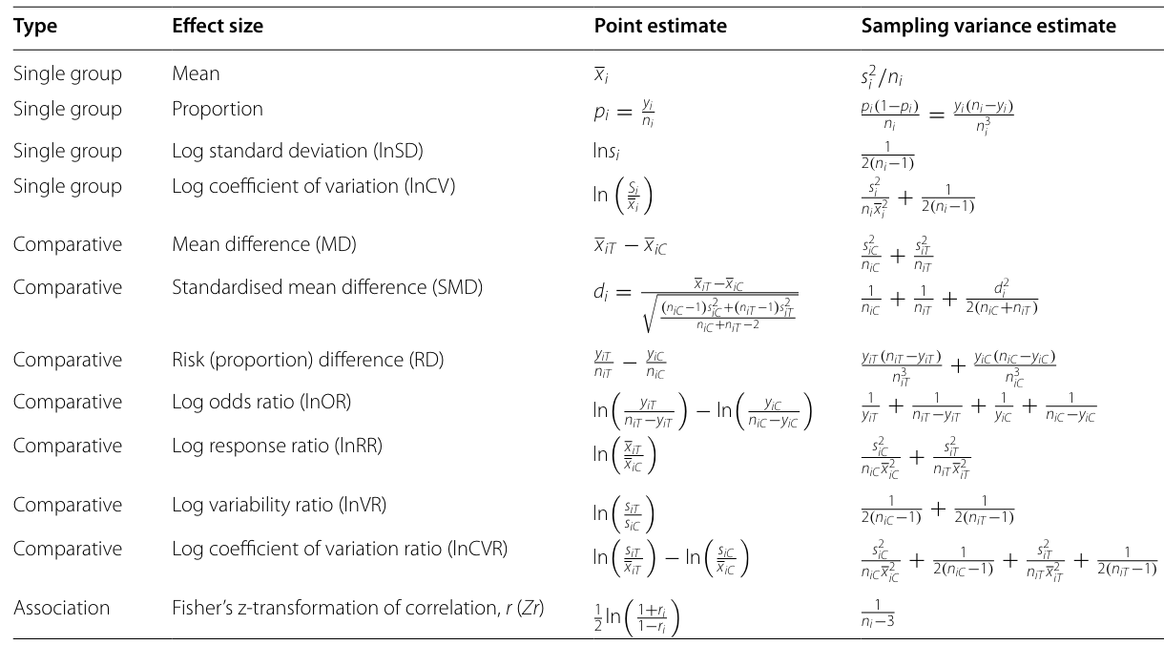
Source: Nakagawa, S., Yang, Y., Macartney, E.L., Spake, R. and Lagisz, M., 2023. Quantitative evidence synthesis: a practical guide on meta-analysis, meta-regression, and publication bias tests for environmental sciences. Environmental Evidence, 12(1), p.8.

Slide 31
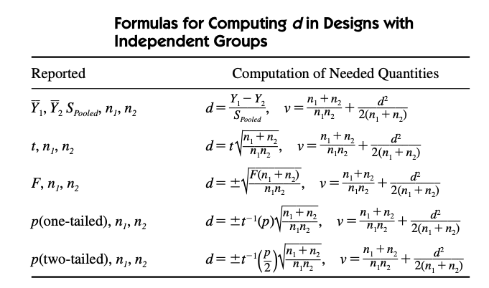
Source: Cooper, H., Hedges, L.V. and Valentine, J.C. eds., 2019. The handbook of research synthesis and meta-analysis. Russell Sage Foundation.

Slide 32
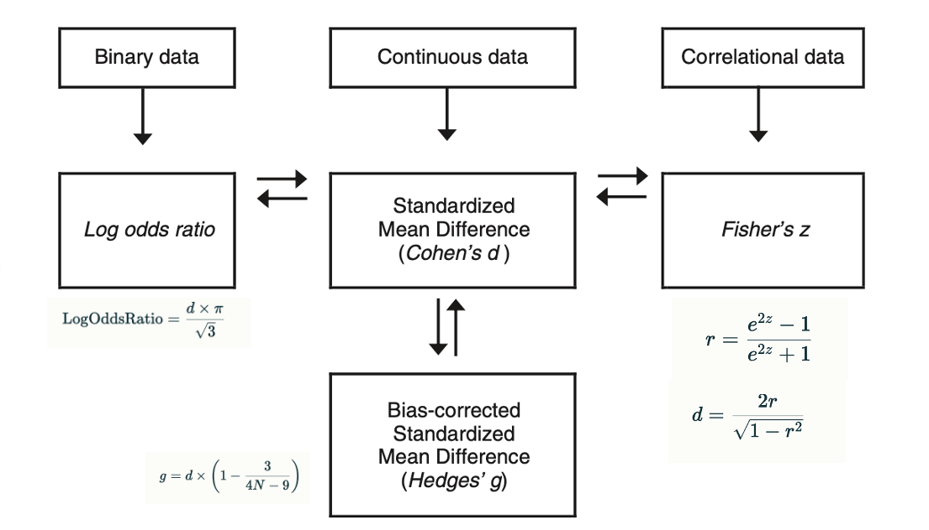
Converting among effect sizes
Source: Cooper, H., Hedges, L.V. and Valentine, J.C. eds., 2019. The handbook of research synthesis and meta-analysis. Russell Sage Foundation.

Slide 33
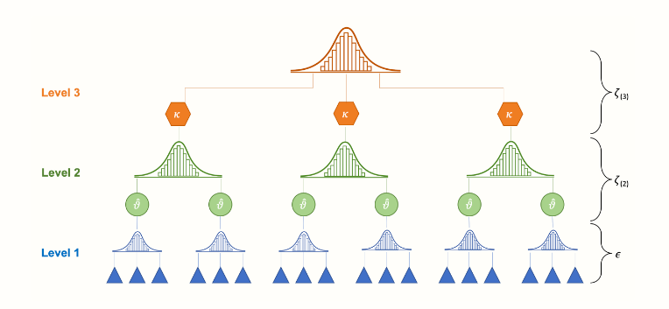
Handling Multiple Effect Sizes from a Single Study
Select a single effect size per study to avoid dependency.
  Choose one effect size randomly if all are conceptually equivalent.
  Use a predefined rule to select the most relevant effect size.
  Average the effect sizes when they measure the same construct and are comparable.
Include multiple effect sizes per study but account for their statistical dependency.
  Multilevel Meta-Analysis.
  Robust Variance Estimation.

Slide 34
5. Modelling Main Effects, Heterogeneity, and Correcting for Biases

Slide 35
Fixed vs. Random Effects Models
Fixed-Effects Model:
  Assumes all studies estimate a single true effect size.
  Differences between study results are due to sampling error.
Random-Effects Model:
  Assumes true effect sizes vary across studies due to real differences .
  Accounts for both within-study variance and between-study variance.

Slide 36
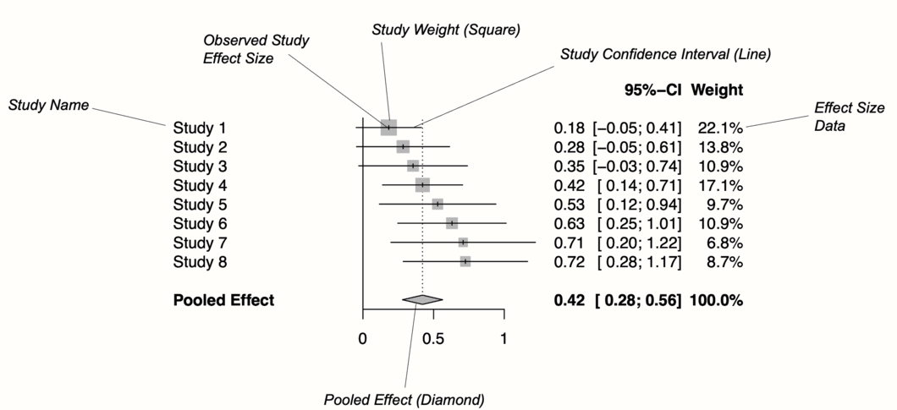
Forest plot
Source: Guide, A.H.O., 2022. Doing Meta-Analysis with R. Boca Raton, FL and London

Slide 37


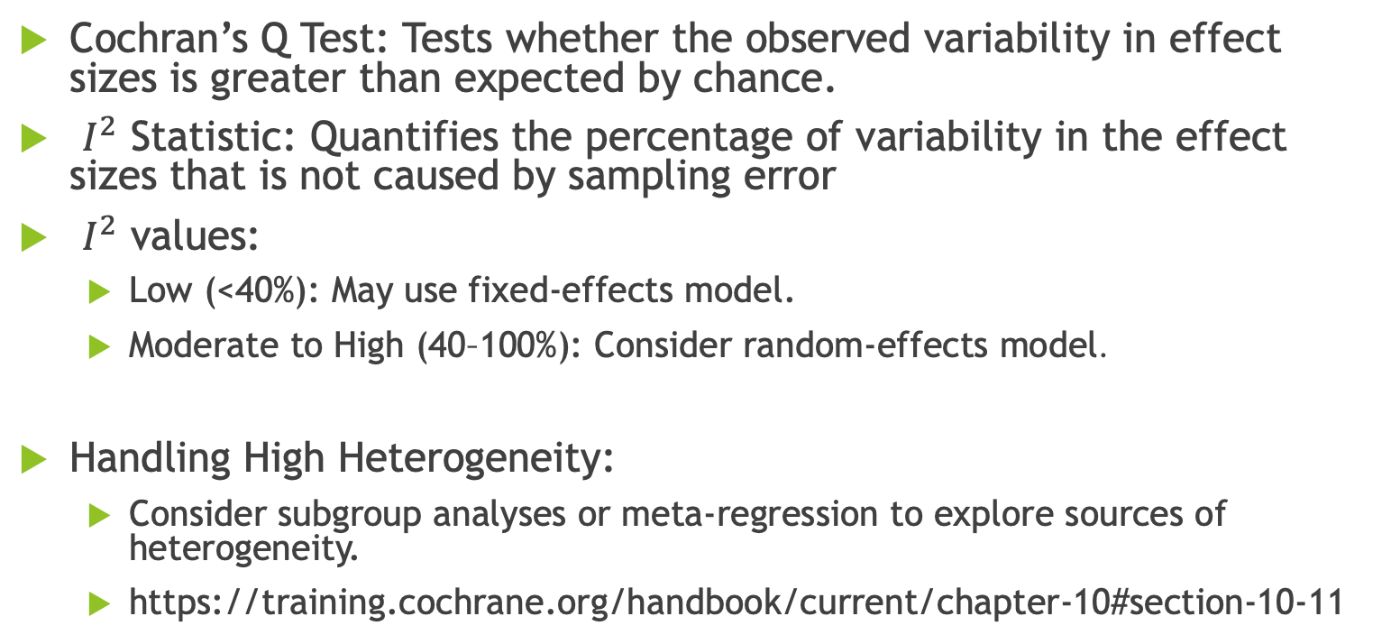
Assessing Heterogeneity
Cochran’s Q Test: Tests whether the observed variability in effect sizes is greater than expected by chance.
$I^{2}$ Statistic: Quantifies the percentage of variability in the effect sizes that is not caused by sampling error
$I^{2}$ values:
  Low (<40%): May use fixed-effects model.
  Moderate to High (40–100%): Consider random-effects model.
Handling High Heterogeneity:
  Consider subgroup analyses or meta-regression to explore sources of heterogeneity.
  https://training.cochrane.org/handbook/current/chapter-10#section-10-11

Slide 38
Publication Bias
Studies with significant results are more likely to be published.
Published studies are more likely to be included in a meta-analysis.
Other sources of bias.
  Language, availability, cost, familiarity, citation etc.

Slide 39

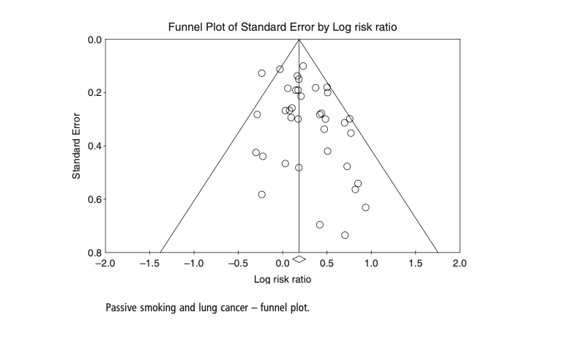
Funnel Plot
Egger’s Test
precision
The intercept provides a measure of asymmetry
Source: Borenstein, M., Hedges, L.V., Higgins, J.P. and Rothstein, H.R., 2021. Introduction to meta-analysis. John Wiley & Sons.

Slide 40
Bias Correction
Trim-and-Fill method by Duval and Tweedie (2000a, 2000b).
Trimming Phase:
  The algorithm removes the most extreme small studies from the positive side of the funnel plot, contributing to asymmetry.
  After each removal, it recalculates the overall effect size until symmetry is achieved.
Filling Phase:
  Once symmetry is reached, the algorithm imputes missing studies by adding mirror-image counterparts on the opposite side of the funnel plot.
  These imputed studies balance the funnel plot and correct for variance, leading to more reliable confidence intervals.

Slide 41
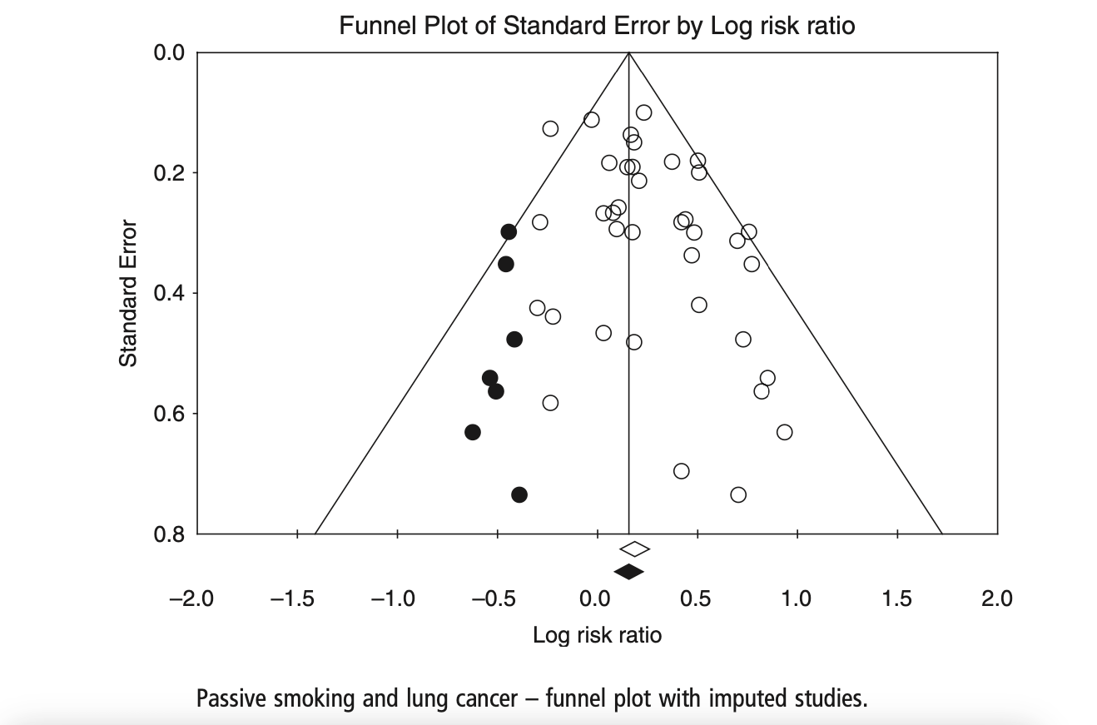
Trim-and-Fill
Source: Borenstein, M., Hedges, L.V., Higgins, J.P. and Rothstein, H.R., 2021. Introduction to meta-analysis. John Wiley & Sons.

Slide 42
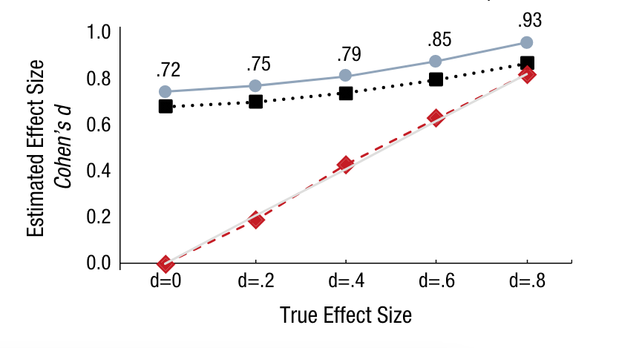
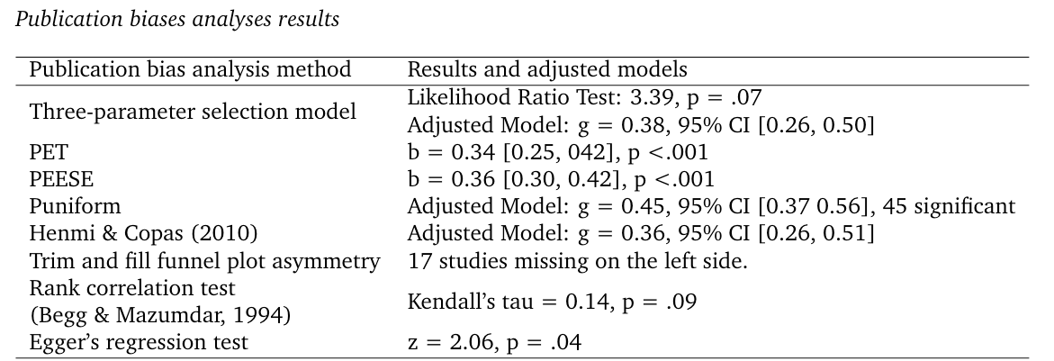

Bias Correction – Other Methods
Although Trim and Fill is in common use, it rests on the unlikely assumption that the selective reporting of studies is driven by effect size rather than statistical significance.
p-curve
Sources:
Simonsohn, U., Nelson, L. D., & Simmons, J. P. (2014). p-Curve and Effect Size: Correcting for Publication Bias Using Only Significant Results. Perspectives on Psychological Science, 9(6), 666-681.
Fillon, A., Souchet, L., Pascual, A. and Girandola, F., 2023. The effectiveness of the “But-you-are-free” technique: Meta-analysis and re-examination of the technique. Meta-Psychology, 7.

Slide 43
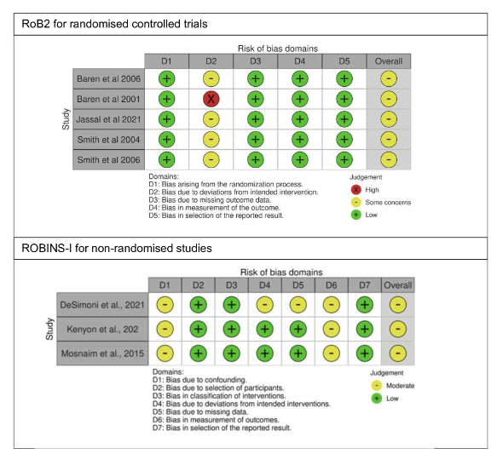
Cochrane Risk-of-Bias Tool
Purpose: To assess the reliability of studies included in a systematic review.
RoB 2 (for Randomized Trials)
ROBINS-I (for Non-Randomized Studies)
https://sites.google.com/site/riskofbiastool/welcome/rob-2-0-tool?authuser=0
Source: Hine, J., Lee, B., Bush, A., De Simoni, A., Griffiths, C., Judah, G. and Fleming, L., 2023. Patient financial incentives to improve asthma management: a systematic review. BMJ open, 13(7), p.e070761.

Slide 44

Useful Packages
R
  metafor, meta, robumeta, netmeta, dosresmeta
  Harrer, M., Cuijpers, P., Furukawa, T. A., & Ebert, D. D. (2021). Doing Meta-Analysis with R: A Hands-On Guide.
  https://bookdown.org/MathiasHarrer/Doing_Meta_Analysis_in_R/
STATA
  metan, metareg, mvmeta
Python
  MetaPype, PyMeta, MIXMeta

Slide 45
Components of Good Meta-Analyses
Comprehensive search to locate all relevant published and unpublished work. Appropriate and rigorous documentation of every step.
Systematic integration of search results.
Critique of the extent, nature, and quality of evidence.
Synthesizing studies to draw broad theoretical conclusions about what a literature means, linking theory to evidence.

Slide 46
Conclusions
  Science proceeds by accumulating evidence.
  Meta-analysis helps this accumulation to take place systematically and rigorously.
  It requires strong resources, local expertise and statistical literacy.
  Decades of research have produced methods and best practices for literature search, statistical analysis and rigorous documentation.
Notes:
Meta-analyses undertaken with the aim of reaching broad generalizations deliberately incorporate results from heterogeneous populations so that broad generalizations and the factors that modify them can be examined and tested. This approach is common in the fields of EEC and in some social sciences, in which meta-analyses have been used to address fundamental problems, to weigh the evidence for prominent theories or hypotheses and to consider the generality of common findings, observations or phenomena.

Slide 47
Readings
Belur, J., Tompson, L., Thornton, A., & Simon, M. (2021). Interrater reliability in systematic review methodology: exploring variation in coder decision-making. Sociological methods & research, 50(2), 837-865.
Borenstein M, Hedges LV, Higgins JPT, Rothstein HR. Introduction to Meta-Analysis. John Wiley & Sons; 2009.
Cochrane Handbook for Systematic Reviews of Interventions. Publication Bias and Funnel Plots. Chapter 10. 2021. Available from: https://handbook-5-1.cochrane.org/chapter_10/10_4_4_2_trim_and_fill.htm
Cooper, Harris, Larry V. Hedges, and Jeffrey C. Valentine, eds. The handbook of research synthesis and meta-analysis. Russell Sage Foundation, 2019.
Duval S, Tweedie R. A nonparametric “trim and fill” method of accounting for publication bias in meta-analysis. J Am Stat Assoc. 2000 Mar;95(449):89–98.
Duval S, Tweedie R. Trim and fill: A simple funnel-plot-based method of testing and adjusting for publication bias in meta-analysis. Biometrics. 2000 Jun;56(2):455–63.
Fillon, A., Souchet, L., Pascual, A. and Girandola, F., 2023. The effectiveness of the “But-you-are-free” technique: Meta-analysis and re-examination of the technique. Meta-Psychology, 7.
Gurevitch J, Koricheva J, Nakagawa S, Stewart G. Meta-analysis and the science of research synthesis. Nature. 2018 Mar 8;555(7695):175-82.
Gusenbauer, M. and Haddaway, N.R., 2020. Which academic search systems are suitable for systematic reviews or meta‐analyses? Evaluating retrieval qualities of Google Scholar, PubMed, and 26 other resources. Research synthesis methods, 11(2), pp.181-217.
Harrer M, Cuijpers P, Furukawa TA, Ebert DD. Doing Meta-Analysis with R: A Hands-On Guide. Boca Raton, FL and London: Chapman & Hall/CRC Press; 2021.

Slide 48
Readings
Hine, J., Lee, B., Bush, A., De Simoni, A., Griffiths, C., Judah, G. and Fleming, L., 2023. Patient financial incentives to improve asthma management: a systematic review. BMJ open, 13(7), p.e070761.
Hedges LV, Tipton E, Johnson MC. Robust variance estimation in meta-regression with dependent effect size estimates. J Res Educ Eff. 2010 Jan;5(1):63–82.
Lombard, Matthew, Jennifer Snyder-Duch, and Cheryl Campanella Bracken.2002. “Content Analysis in Mass Communication: Assessment and Reporting of Intercoder Reliability.” Human Communications Research 28(4):587-604.
Nakagawa, S., Yang, Y., Macartney, E. L., Spake, R., & Lagisz, M. (2023). Quantitative evidence synthesis: a practical guide on meta-analysis, meta-regression, and publication bias tests for environmental sciences. Environmental Evidence, 12(1), 8.
Page, Matthew J., et al. "The PRISMA 2020 statement: an updated guideline for reporting systematic reviews. Pan American Journal of Public Health 46 (2022): e112-e112.
Park S, Beretvas SN. Performance of three-level models and robust variance estimation in handling multiple outcomes per study in meta-analysis. Behav Res Methods. 2019 Aug;51(4):1638–52.
Pieper D, Rombey T. Where to prospectively register a systematic review. Systematic Reviews. 2022 Jan 8;11(1):8.
Rosenthal R, Rosnow RL. Essentials of Behavioral Research: Methods and Data Analysis. McGraw-Hill Book Company; 1991.
Simonsohn, U., Nelson, L. D., & Simmons, J. P. (2014). p-Curve and Effect Size: Correcting for Publication Bias Using Only Significant Results. Perspectives on Psychological Science, 9(6), 666-681.
Sterne JAC, Egger M. Funnel plots for detecting bias in meta-analysis: Guidelines on choice of axis. J Clin Epidemiol. 2001 Oct;54(10):1046–55.
Terrin N, Schmid CH, Lau J, Olkin I. Adjusting for publication bias in the presence of heterogeneity. Stat Med. 2003 Jul;22(13):2113–26.
Van den Noortgate W, López-López JA, Marín-Martínez F, Sánchez-Meca J. Three-level meta-analysis of dependent effect sizes. Behav Res Methods. 2013 Jun;45(2):576–94.

